Slide 1
Lecture 6
Pointers
Konstantin Leladze
C++ Basics
DIHT MIPT 2021

Slide 2
Quick recap
I would like to be able to use arrays even if the size is large.
In the case of a regular array, if you use a large size, a RunTime Error (Segmentation Fault) will occur.
int a[150]; /// OK
int a[10000000]; /// RE
So how to create large arrays?
Also:
a [150] = 3;
This code will work, but why ???
Moreover, even the following code works: a[-5] = 4;
Let's figure out what happens at the physical level.

Slide 3
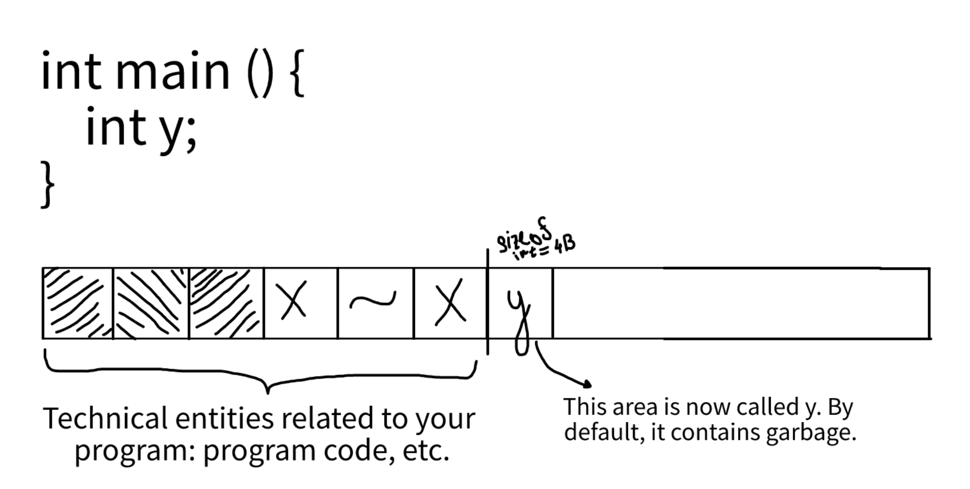
What happens at the physical level
When a program is launched, the operating system allocates a fixed amount of memory in the computer's RAM. This is usually 4-8 megabytes.
When you declare something in your program, a certain number of bytes is reserved is the special memory area.

Slide 4
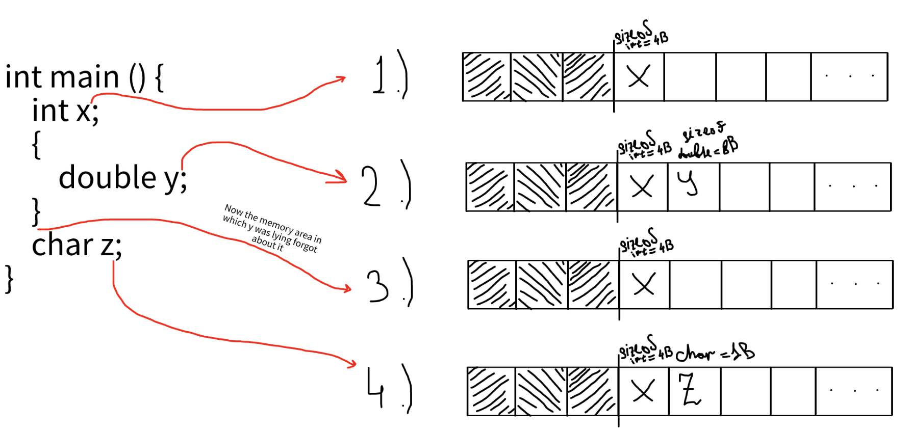
What happens at the physical level
Another example:

Slide 5
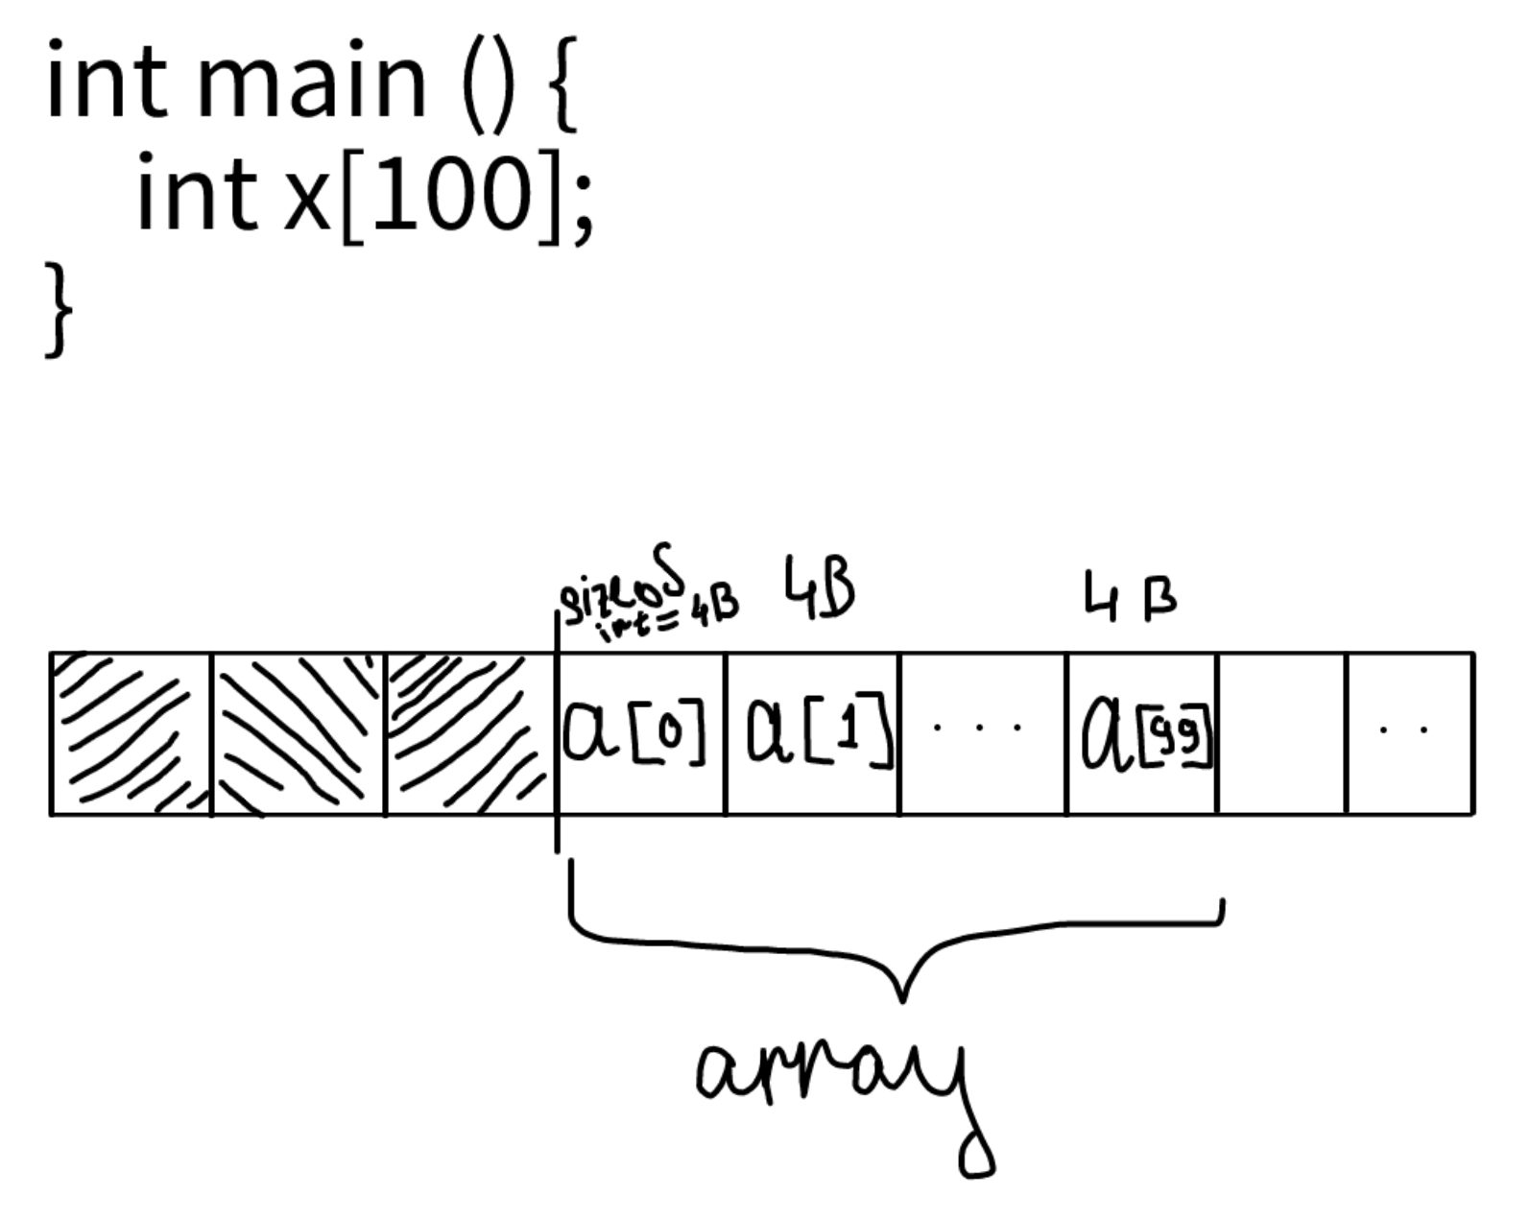
What happens at the physical level
Example with an array:

Slide 6
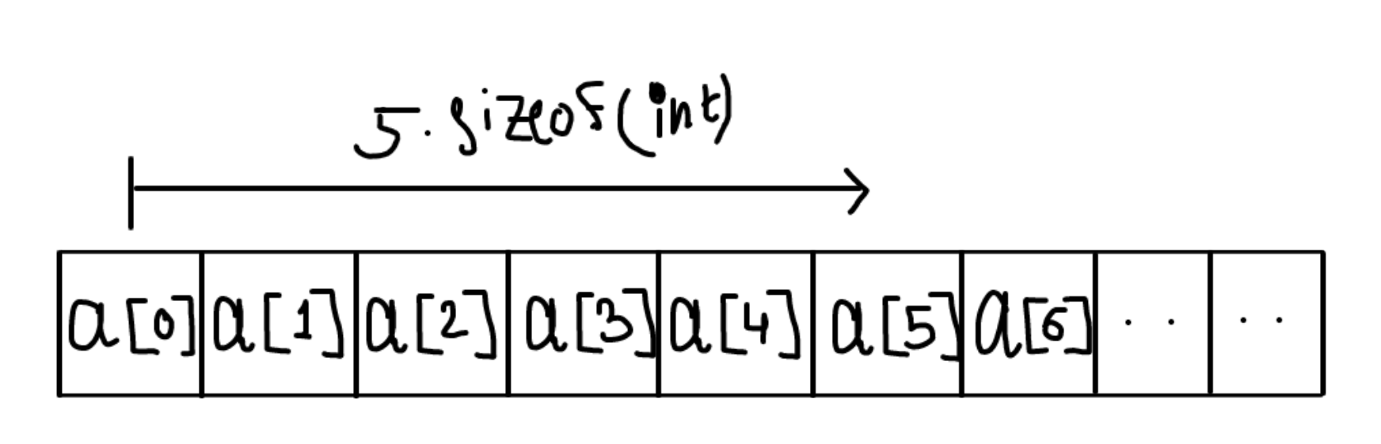
What happens at the physical level
The area of ​​memory discussed is called the stack.
What happens when you access a[5]? The executor understands that he needs to take the sixth element of the array. Now, let's imagine that he has a "coordinate” of the first element of this array a in memory. Then, to get the sixth element of the array, he needs to add 5 to this coordinate, or, in other words, shift it 5 steps to the right. However, you need to take into account that each step must be exactly sizeof(int) = 4Bytes wide.

Slide 7

Pointers
We smoothly arrived at the concept of a pointer. What it is?
Pointer is a special data type that is used to represent different addresses in memory.
A memory address is a hexadecimal number representing a coordinate in memory:
int* x; ← pointer to int, type of x is int*
int* is a type which stores the memory address in which the int x lies.

Slide 8
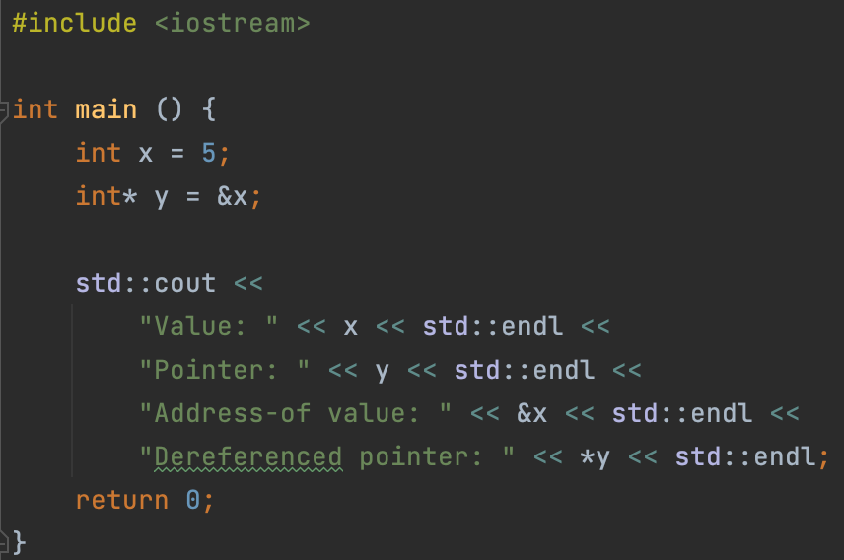
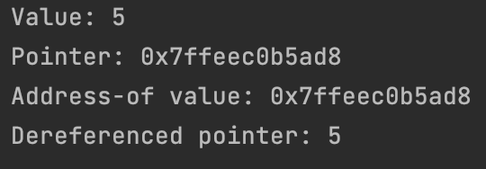
Operations with pointers
1) Unary operator &, aka address-of (don’t confuse with the binary bitwise operator &).
Returns the address in memory at which the variable is located.
precedence: 3
associativity: right-to-left
2) Unary operator *, aka dereferencing
Returns the value to which the pointer is pointing.
precedence: 3
associativity: right-to-left

Slide 9
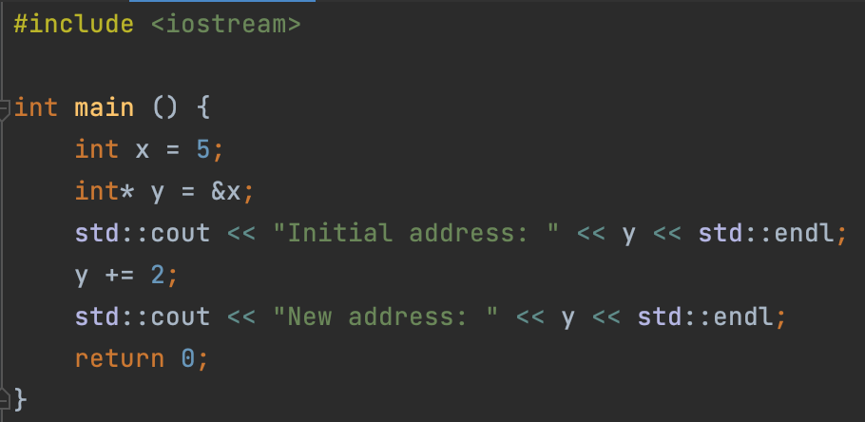

Operations with pointers
3) Incrementing / decrementing pointers.
By adding a number to the pointer, you shift this number of steps to the
right (if the number is positive), or to the left (if the number is negative).

Slide 10
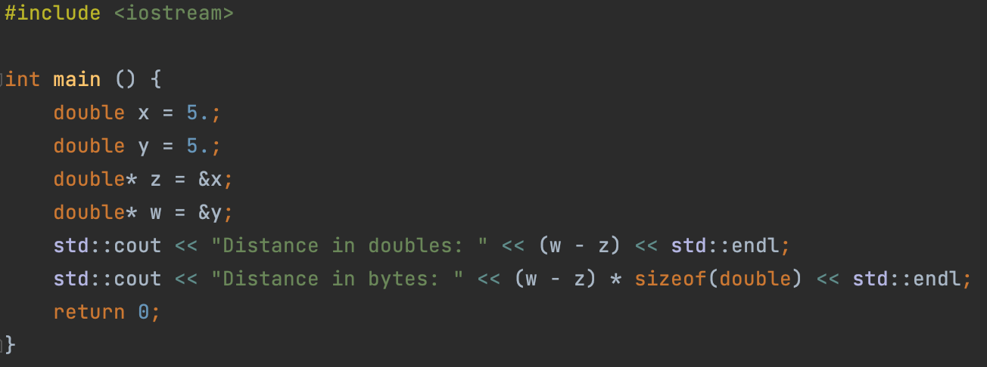

Operations with pointers
4) Difference of two pointers.
By subtracting two pointers, you will know the distance between them in memory.
But this distance will NOT be in the number of bytes, but in the number of elements
of the pointer type.
So, to find out the number of bytes between two pointers to double, for example, you need to multiply the difference of pointers by sizeof(double).

Slide 11
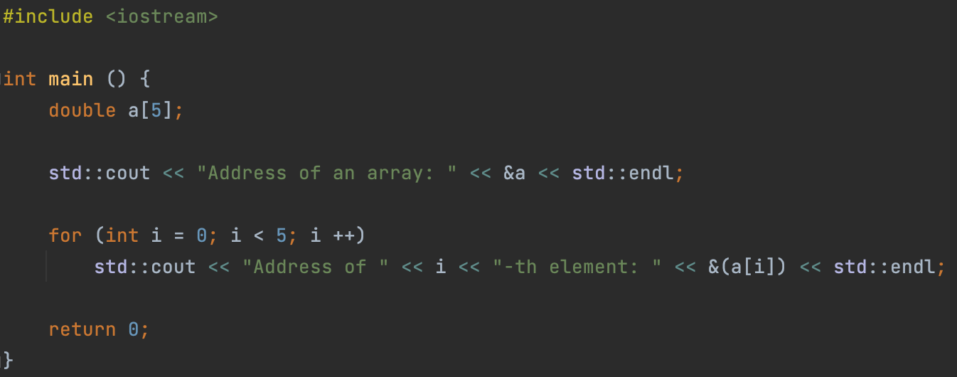
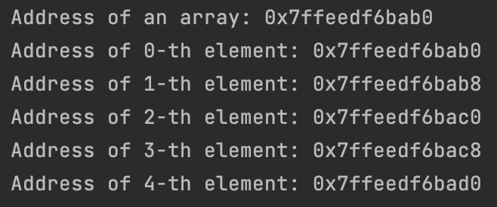
Operations with pointers
5) Operator [], aka subscript operator.
Applies to arrays. a[i] returns the array element with index i.
Precedence: 2
Associativity: left-to-right
Let’s try to print address of an array and its elements.
We see an important property: the address of the array coincides with the address of the element with index 0 in it, and the distance between adjacent elements is always 1.

Slide 12
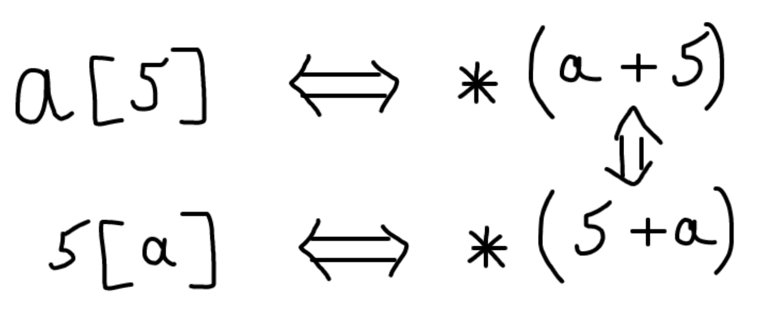
Operations with pointers
In fact, when the [] operator is applied to the array a, the result is calculated as follows:
Finally, we understand why the first element in the array has index 0!

Slide 13
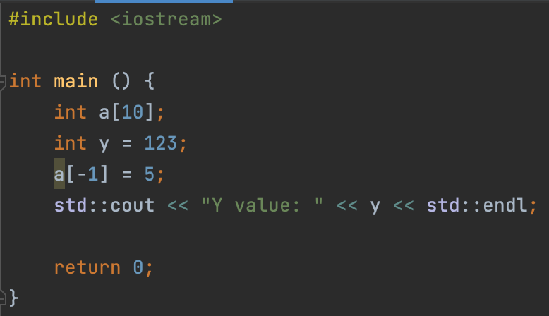

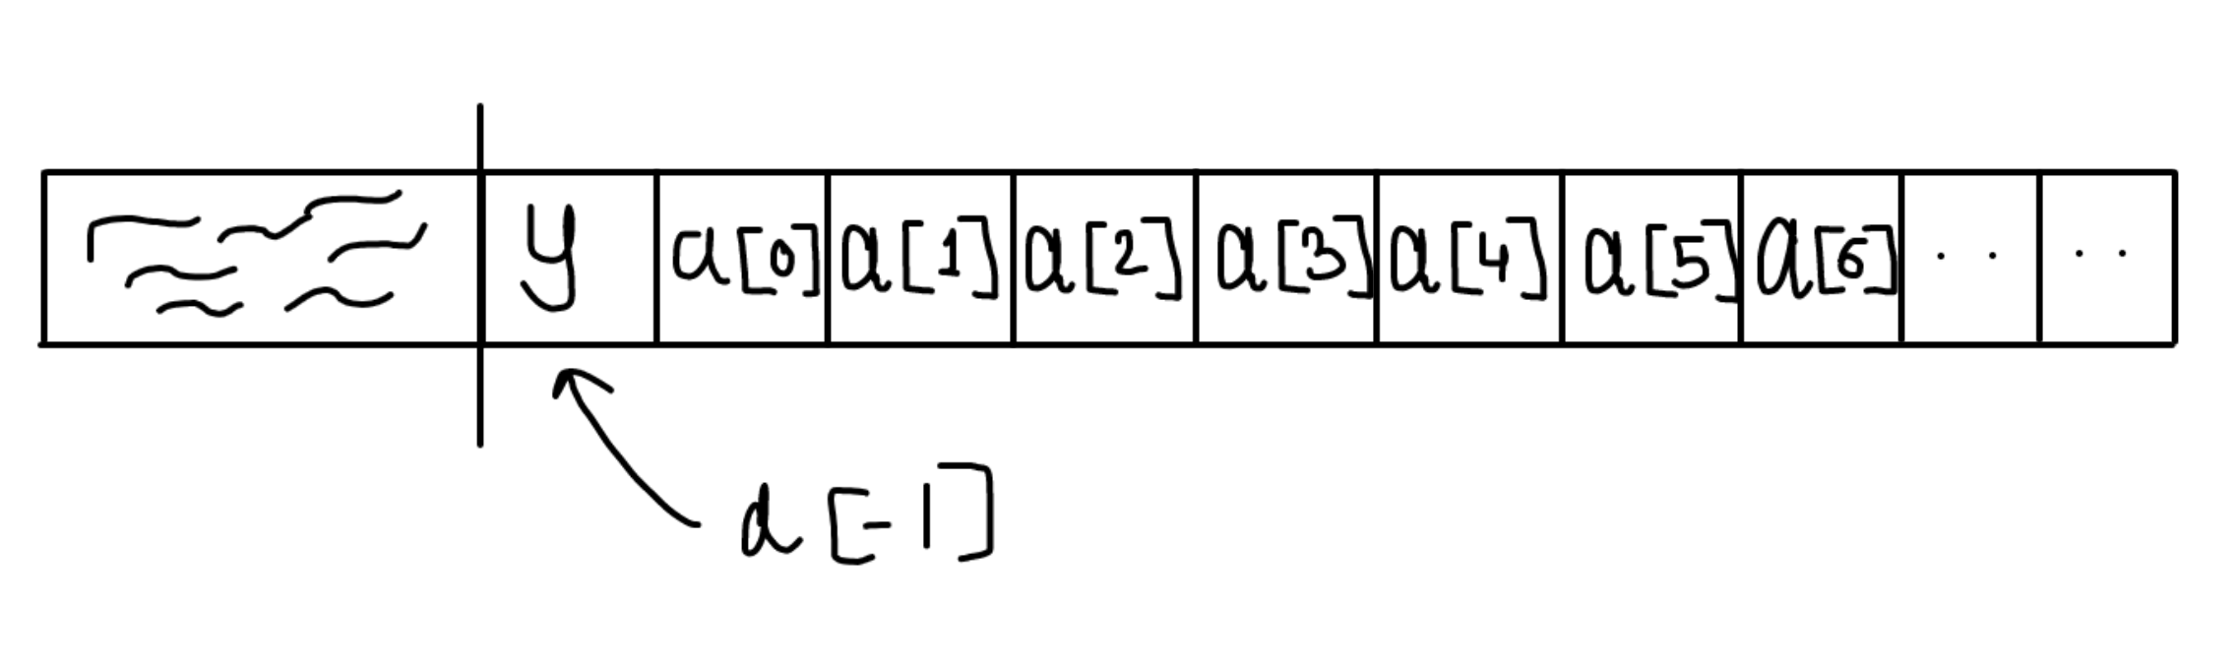
Operations with pointers
It is possible to access memory not associated with the current array.

Slide 14
Dynamic memory
You cannot allocate very large arrays, because the stack size is limited. But how, then, to create very large arrays ?! For example, a size of 10,000,000 items. The solution is the so-called dynamic memory. The fact is that there is a tool with which you can ask your OS to give you more memory than you currently have available (usually 4-8 megabytes are available).
This is the new and delete operators, which allocate and deallocate heap respectively. Heap memory is located not on the stack, but in another area called the heap.

Slide 15
Operators new and delete
Operators new and delete have two versions:
The first is used to allocate and deallocate one value (cell).
The second is to allocate and deallocate an entire array (sequence) of cells.
Operator new:
Allocates new one cell.s
Operator delete:
Deallocates one cell.
Operator new[]:
Allocates new chunk (array) of cells (amount should be provided)
Operator delete[]:
Deallocates new chunk of cells (amount should be provided)
Precedence: 3
Associativity: right-to-left
RULE: All memory allocated by your program must be deallocated!

Slide 16
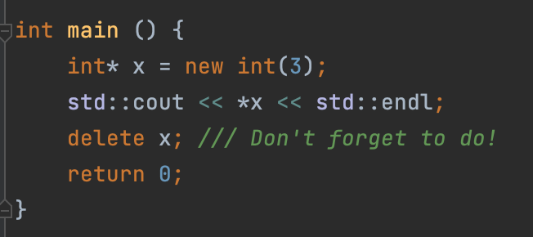
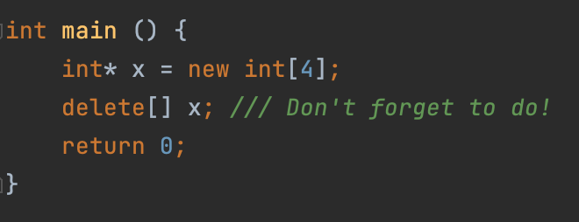
Operators new and delete, syntax
One cell:
3 is a value which will be used to initialize the variable x
Array:
4 in this case is the size of the array, not the value of it!

Slide 17
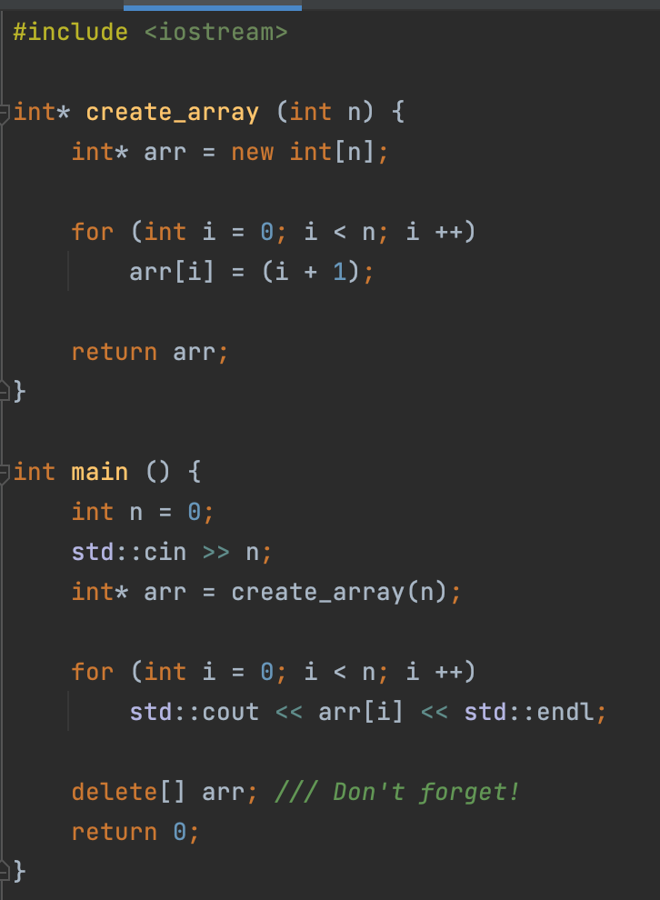

Operators new and delete
Now is the time to talk about how to declare arrays that do not end in curly braces.
Example: allocating an array in a function and returning it from a function.
In fact, this can also be done with dynamic memory and using the new and delete operators!

Slide 18
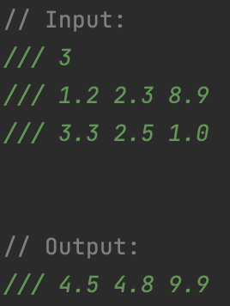
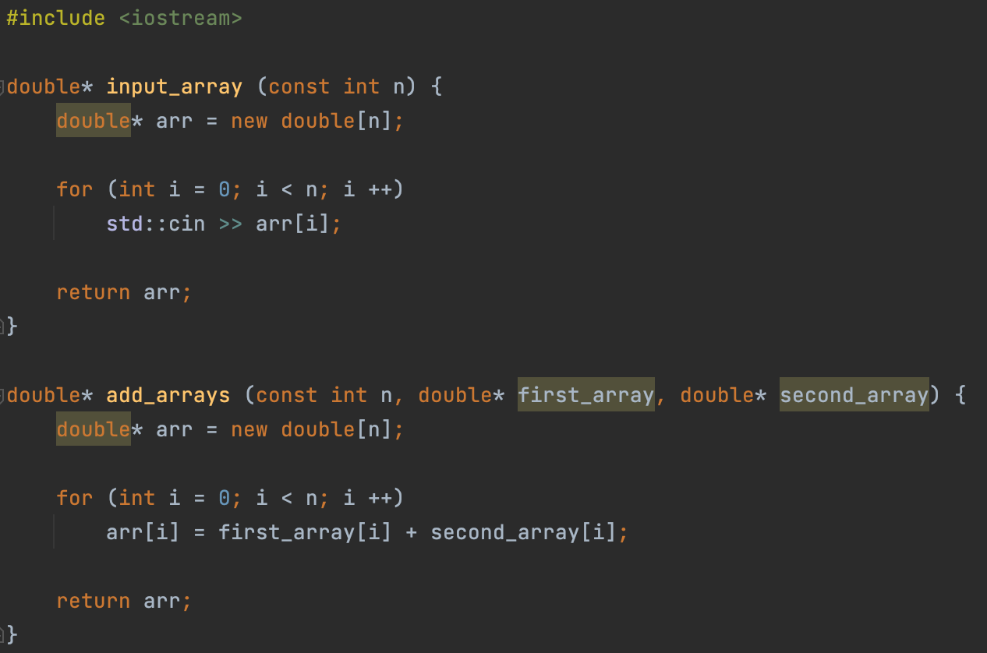
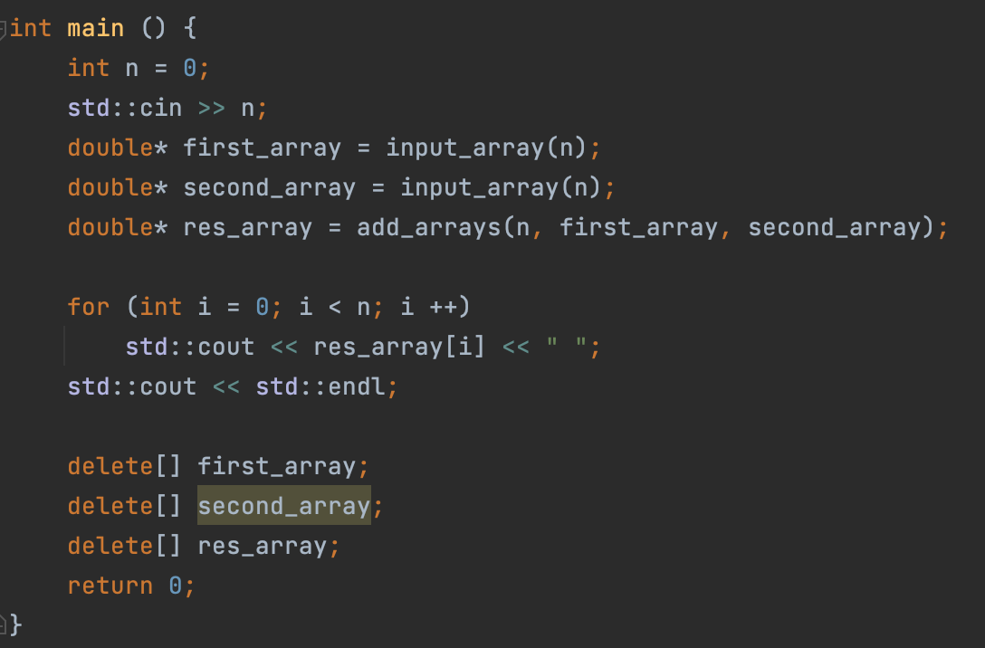
Example
Input two arrays of doubles and output sum of these arrays.

Slide 19
Lecture 6
Pointers
Konstantin Leladze
C++ Basics
DIHT MIPT 2021

